Slide 1
Animal Species Classification
RAMANUJAN NR (210701206)
RAMKEERTHAN MA (210701207)

Slide 2
ABSTRACT
This project demonstrates the use of a ResNet architecture for the classification of ten animal species: dog, cat, elephant, spider, horse, frog, cow, butterfly, sheep, and squirrel. Leveraging a ResNet50 model pre-trained on ImageNet as the base, we add a custom classification head with a 256-unit hidden layer. The model is trained using the sparse categorical cross-entropy loss function and the Adam optimizer. Data augmentation techniques are employed to enhance generalization, and the model achieves a validation accuracy of 90%. This high accuracy is attained through careful model tuning, including fine-tuning the base model layers and implementing regularization strategies. The results underscore the efficacy of transfer learning and advanced neural network architectures in complex image classification tasks.

Slide 3
CONTENTS
1. Understanding ResNet Architecture
2. Application of ResNet in Animal Species Classification
3. Benefits and Challenges of Using ResNet for Animal Species Classification

Slide 4
Introduction to ResNet
Evolution of Neural Networks
ResNet, short for Residual Network, represents a breakthrough in deep learning architecture, designed to address the vanishing gradient problem and enable the training of very deep neural networks.
Residual Learning
The core concept of ResNet lies in residual learning, where the network learns residual functions with reference to the layer inputs, allowing for the training of extremely deep networks.
Architectural Components
ResNet architecture is characterized by residual blocks, skip connections, and the use of identity and projection shortcuts, contributing to its efficiency and effectiveness in feature extraction.

Slide 5
Key features of ResNet
Vanishing Gradient Problem
ResNet's ability to mitigate the vanishing gradient problem empowers the network to effectively learn from a larger number of layers, facilitating more accurate representations of complex data.
Skip Connections
The incorporation of skip connections enables the direct flow of information from one layer to another, preserving gradient flow and simplifying the learning process for the network.
Adaptability to Different Domains
ResNet's architecture is not domain-specific, making it versatile and suitable for a wide range of applications, including image classification and object recognition.

Slide 6
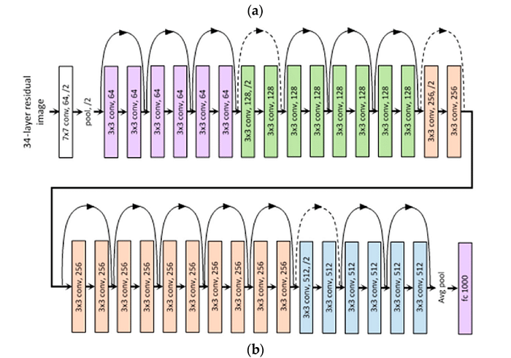
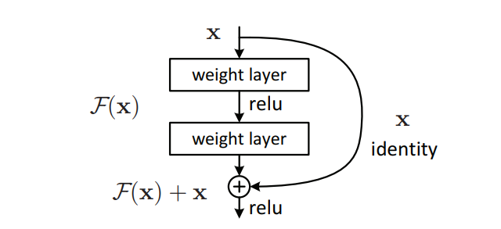
ResNet Architecture

Slide 7
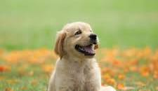
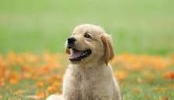
Dataset and Preprocessing
Dataset Selection
The process of selecting and curating a comprehensive dataset of animal images, encompassing diverse species and variations, to ensure the robustness and inclusivity of the classification model.
Image Preprocessing
The application of preprocessing techniques, including resizing, normalization, and augmentation, to optimize the dataset for training ResNet-based models and enhance their generalization capabilities.

Slide 8
Model Development
Architecture Configuration
The configuration of ResNet architecture with a 256 unit hidden layer, specifying the number of layers, filter sizes, and activation functions to tailor the model for animal species classification.
Model Compilation
The model is compiled with loss of sparse categorical crossentropy for multi class classification and uses Adam optimizer
Training Process
The training process involving the utilization of backpropagation, gradient descent, and epoch iterations to optimize the model's parameters and enhance its ability to accurately classify animal species.

Slide 9
ADVANTAGES
High Accuracy
ResNet's architecture enables the development of highly accurate animal species classification models, surpassing the performance of conventional neural network architectures.
Feature Reusability
The reusability of learned features within ResNet's residual blocks enhances the model's ability to extract and leverage discriminative features for animal species classification.

Slide 10
Limitations and Challenges
High Accuracy
ResNet's architecture enables the development of highly accurate animal species classification models, surpassing the performance of Computational Complexity
The increased depth of ResNet architectures may lead to computational challenges, including longer training times and higher resource requirements, impacting practical deployment.
conventional neural network architectures.
Overfitting Risks
The risk of overfitting due to the large number of parameters in deep ResNet models necessitates careful regularization and validation strategies to ensure generalization.

Slide 11
THANK YOU

